Slide 1
Facs judging guide
K-State Research & extension
Coffey county

Slide 2
What is facs judging?
Family and Consumer Science (FACS) judging is….

Slide 3
Junior age division examples

Slide 4
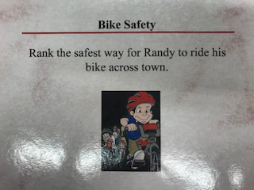
Bike safety

Slide 5
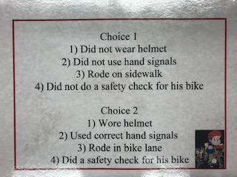
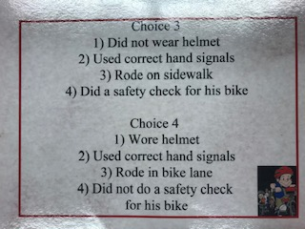
Bike safety
Choice 1 Choice 2
Choice 3 Choice 4

Slide 6
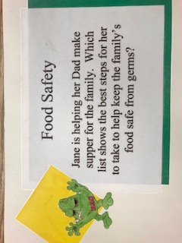
Food safety

Slide 7
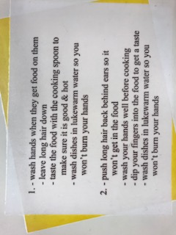
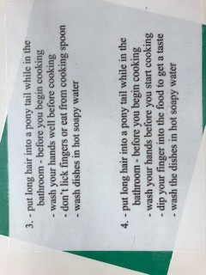
Food safety
Choice 1 Choice 2
Choice 3 Choice 4

Slide 8
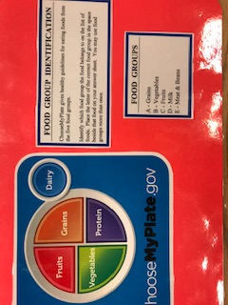
Food group identification
ChooseMyPlate gives health guidelines for eating foods from the five food groups.
Identify which food group the food belongs in the space beside that food on your answer sheet. You may use the food groups more than once.
FOOD GROUPS:
A- Grains
B- Vegetables
C- Fruits
D- Milk
E – Meat & Beans

Slide 9
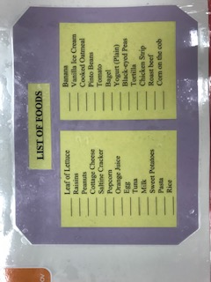
Food group identification

Slide 10
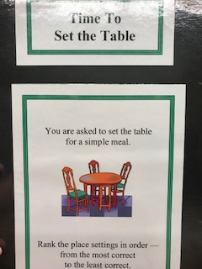
Time to set the table

Slide 11
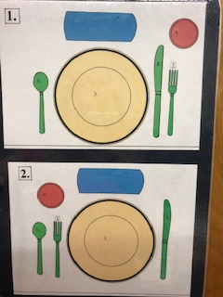
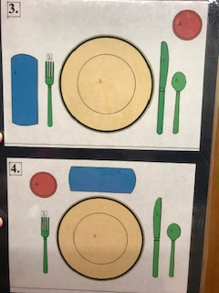
Time to set the table

Slide 12
Intermediate age division examples

Slide 13
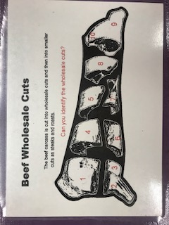
Beef wholesale cuts

Slide 14
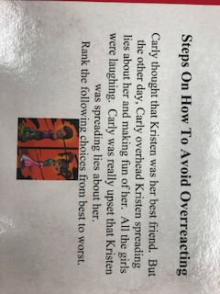
Steps to avoid overreacting

Slide 15
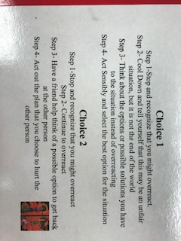
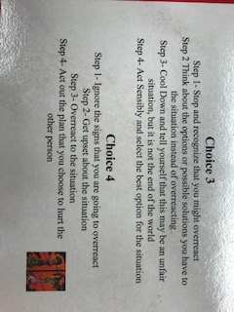
Steps to avoid overreacting
Choice 1 Choice 2
Choice 3 Choice 4

Slide 16
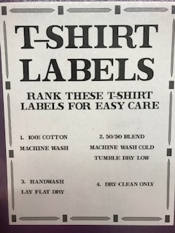
T-shirt labels

Slide 17
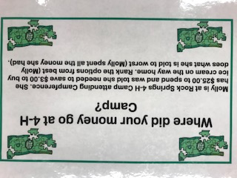
Where’d my money go at camp

Slide 18
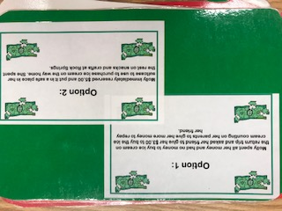
Where’d my money go at camp
Molly spent all her money and had no money to buy ice cream on the return trip and asked her friend to give her $3 to buy the ice cream counting on her parents to hive her more money to repay her friend.
Molly immediately reserved $5 and put it in a safe place in her suitcase to use to purchase ice cream on the way home. She spent the rest on snacks and crafts at Rock Springs.

Slide 19
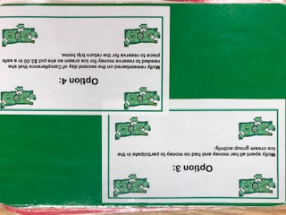
Where’d my money go at camp
Molly spend all her money and had no money to participate in the ice cream group activity.
Molly remembered on the second day of Campference that she needed to reserve money for ice cream so she put $3 in a safe place to reserve for the trip home.

Slide 20
senior age division examples

Slide 21
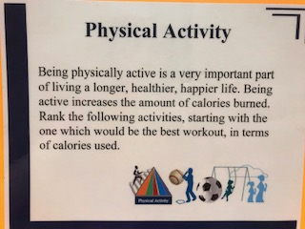
Physical activity

Slide 22
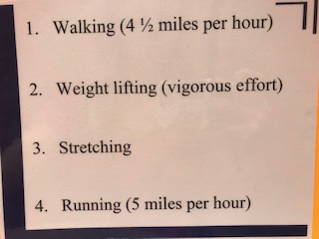
Physical activity

Slide 23
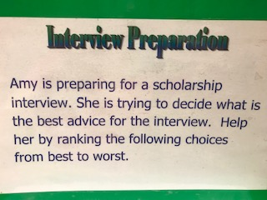
Interview preparation

Slide 24
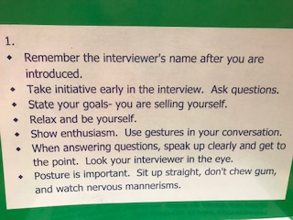
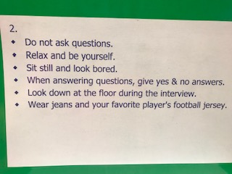
INTERVIEW PREP
Choice 1
Choice 2

Slide 25
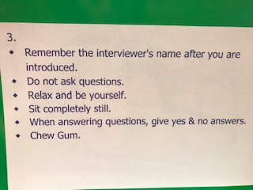
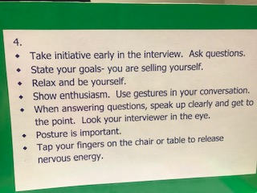
INTERVIEW PREP
CHOICE 3
CHOICE 4

Slide 26
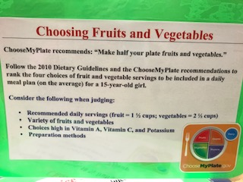
FRUITS AND VEGGIES

Slide 27
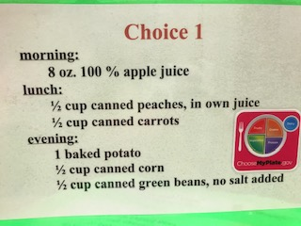
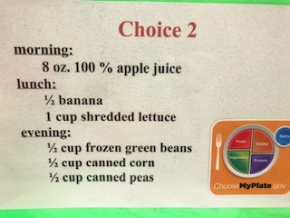
Where’d my money go at camp
Choice 1
Choice 2

Slide 28
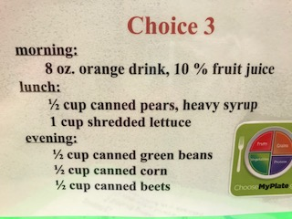
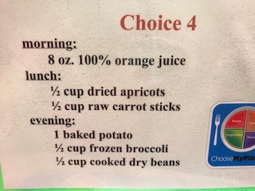
Where’d my money go at camp
Choice 3
Choice 4

Slide 29
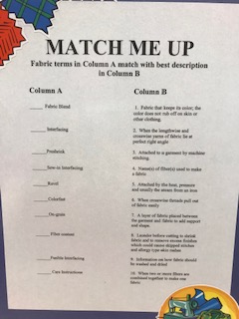
MATCH ME UP
Fabric Blend
Interfacing
Preshrink
Sew-in Interfacing
Ravel
Colorfast
On-grain
Fiber Content
Fusible Interfacing
Care Instructions
Fabric that keeps its color; the color does not rub off on skin or other clothing
When the lengthwise and crosswise yarns of fabric lie at perfect right angle
Attached to a garment by machine stitching
Name(s) of fiber(s) used to make a fabric
Attached by heat, pressure and usually the steam from an iron
When crosswise threads pull out of fabric easily
A layer of fabric placed between the garment and fabric to add support and shape
Launder before cutting to shrink fabric and to remove excess finishes which could cause skipped stitches and allergy type skin rashes
Information on how fabric should be washed and dried
When two or more fibers are combined together to make on fabric

Slide 30
MATCH ME UP
A. Fabric that keeps its color; the color does not rub off on skin or other clothing
B. When the lengthwise and crosswise yarns of fabric lie at perfect right angle
C. Attached to a garment by machine stitching
D. Name(s) of fiber(s) used to make a fabric
E. Attached by heat, pressure and usually the steam from an iron
F. When crosswise threads pull out of fabric easily
G. A layer of fabric placed between the garment and fabric to add support and shape
H. Launder before cutting to shrink fabric and to remove excess finishes which could cause skipped stitches and allergy type skin rashes
I. Information on how fabric should be washed and dried
J. When two or more fibers are combined together to make on fabric
Fabric Blend
Interfacing
Preshrink
Sew-in Interfacing
Ravel
Colorfast
On-grain
Fiber Content
Fusible Interfacing
Care Instructions

